Slide 1
A Fortran-Keras Deep Learning Bridge for Scientific Computing
Jordan Ott, Mike Pritchard, Natalie Best, Erik Linstead, Milan Curcic, Pierre Baldi

Slide 2
Overview
Deep Learning
Popularity and importance
Resources for Deep Learning
Features of FKB
Application to Climate Modeling

Slide 3
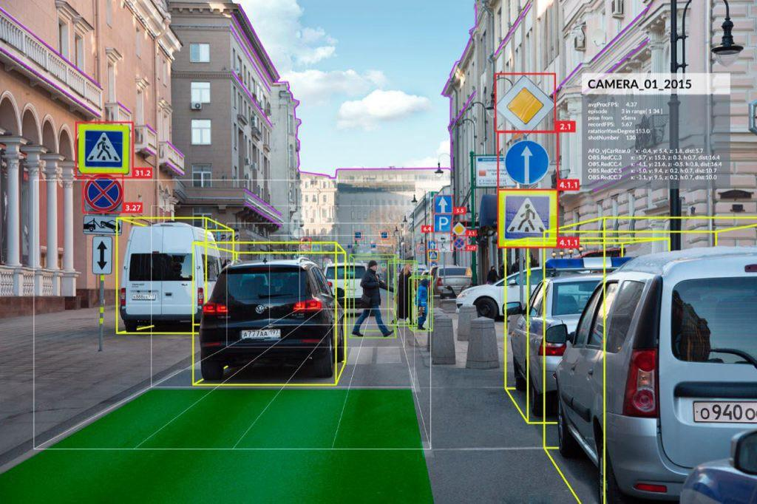
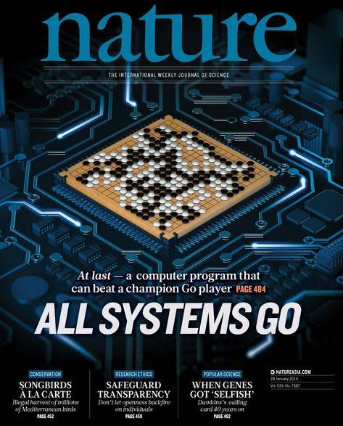
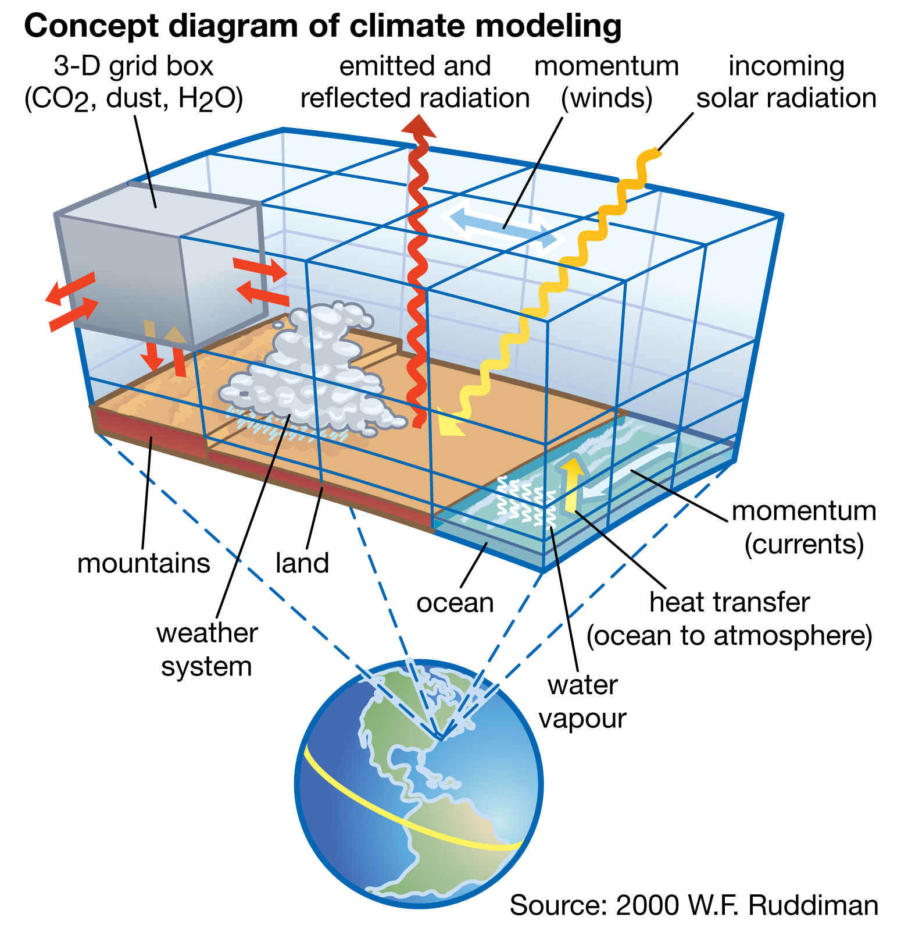
Applications of Deep Learning

Slide 4
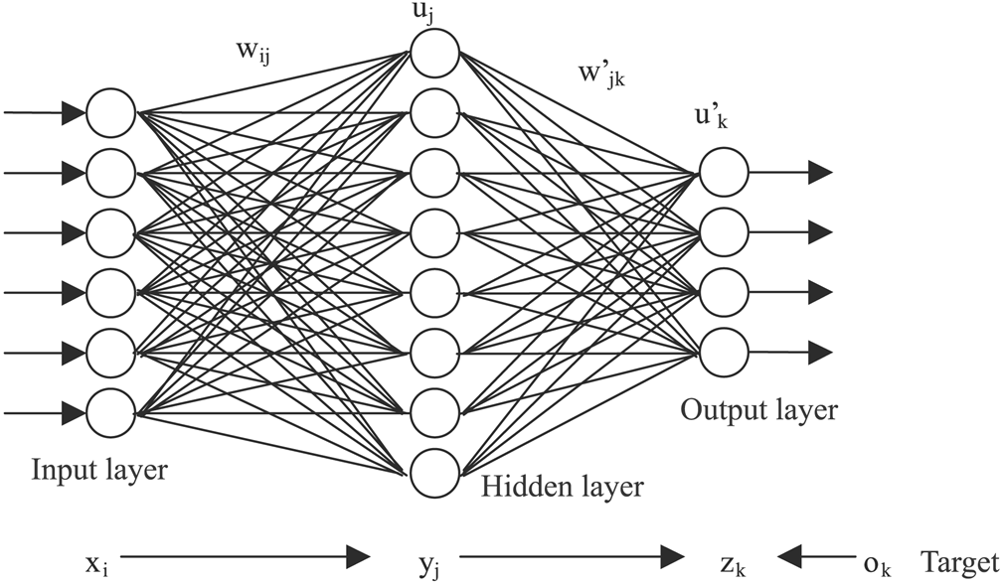
Deep Learning

Slide 5
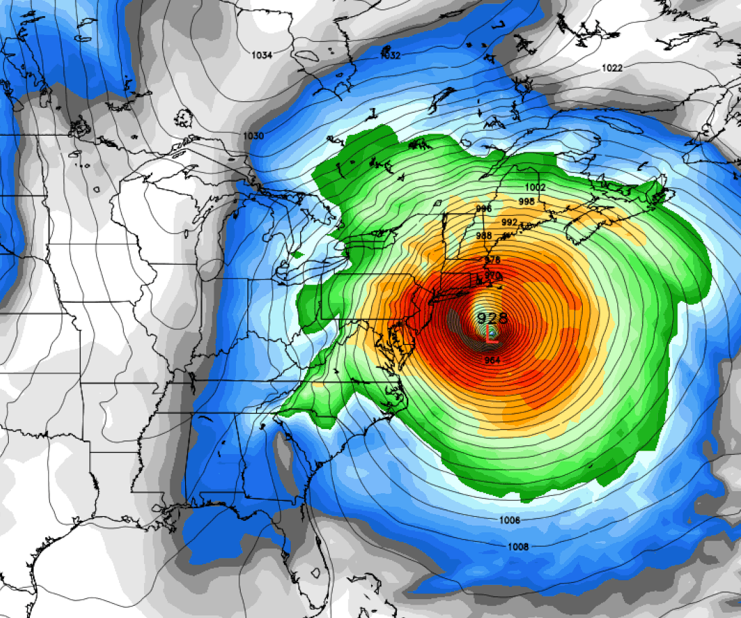
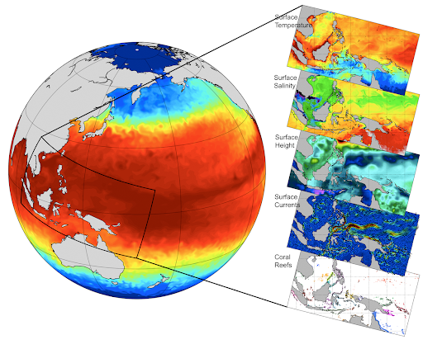
Scarce Deep Learning Resources
Abundant Deep Learning Resources

Slide 6
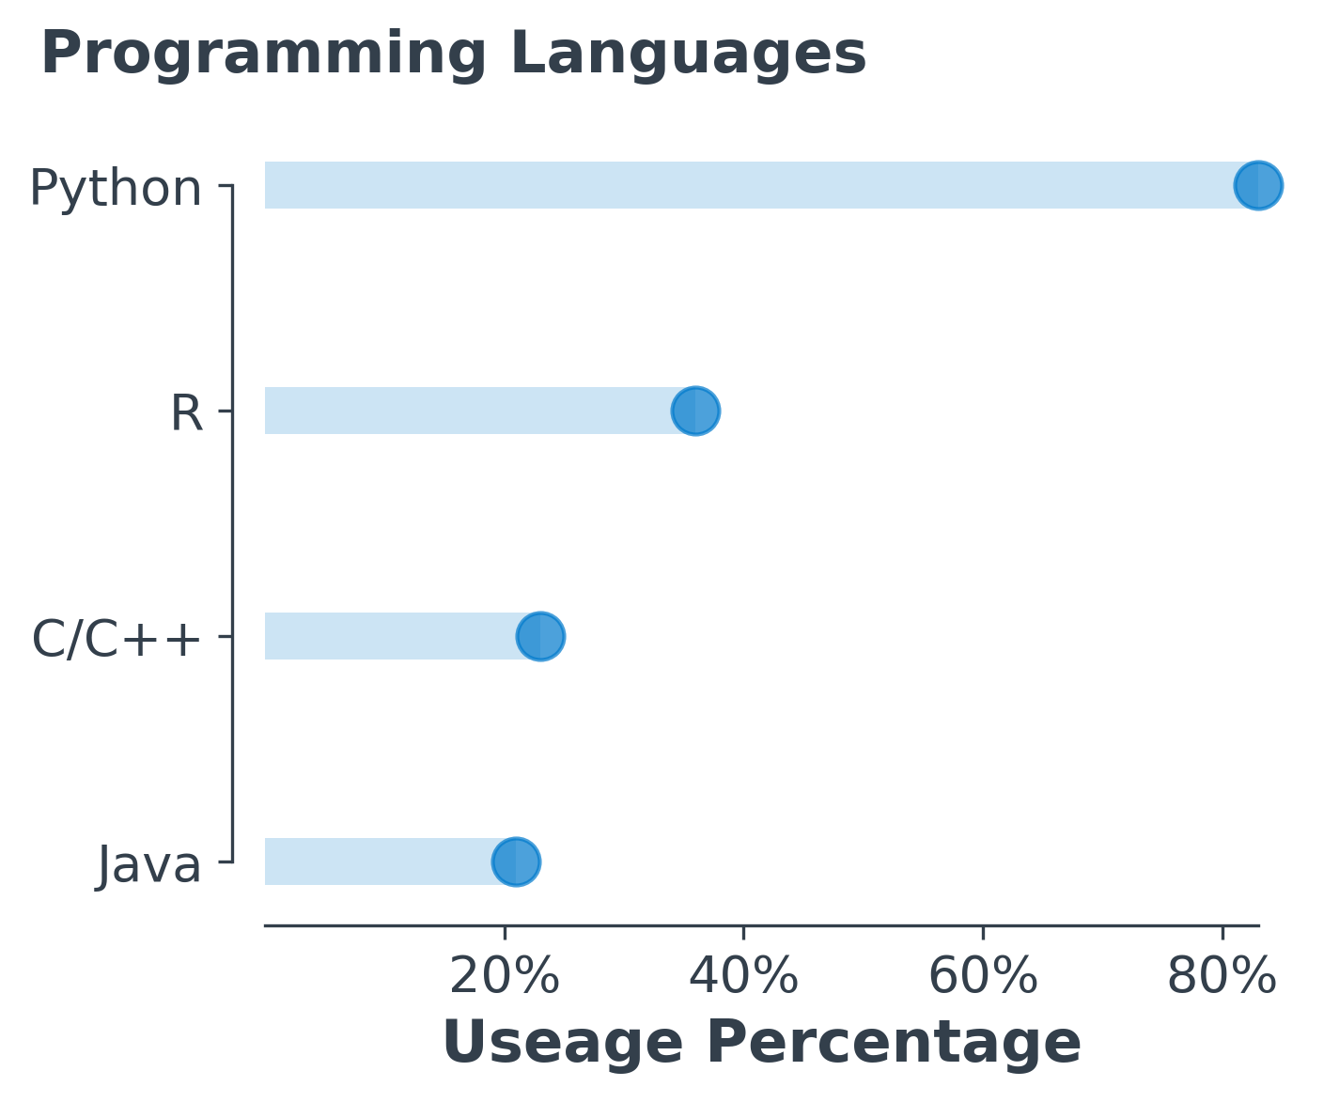
Popularity of Deep Learning
2018 Kaggle ML & DS Survey

Slide 7
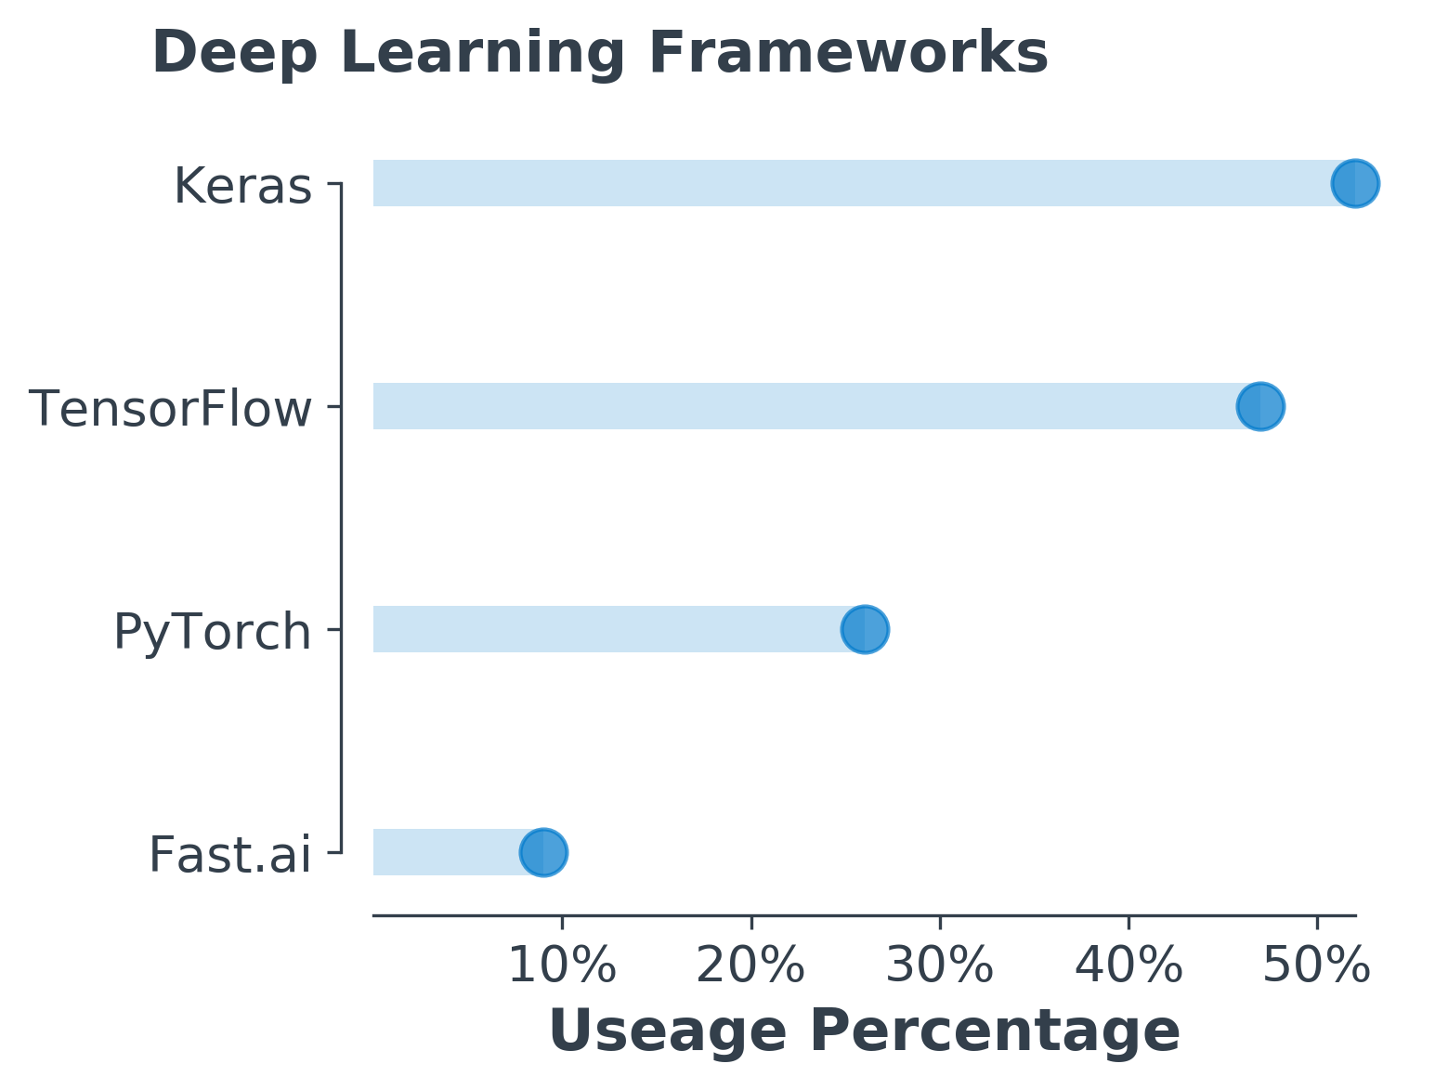
Deep Learning Software
2019 Kaggle State of DS & ML

Slide 8
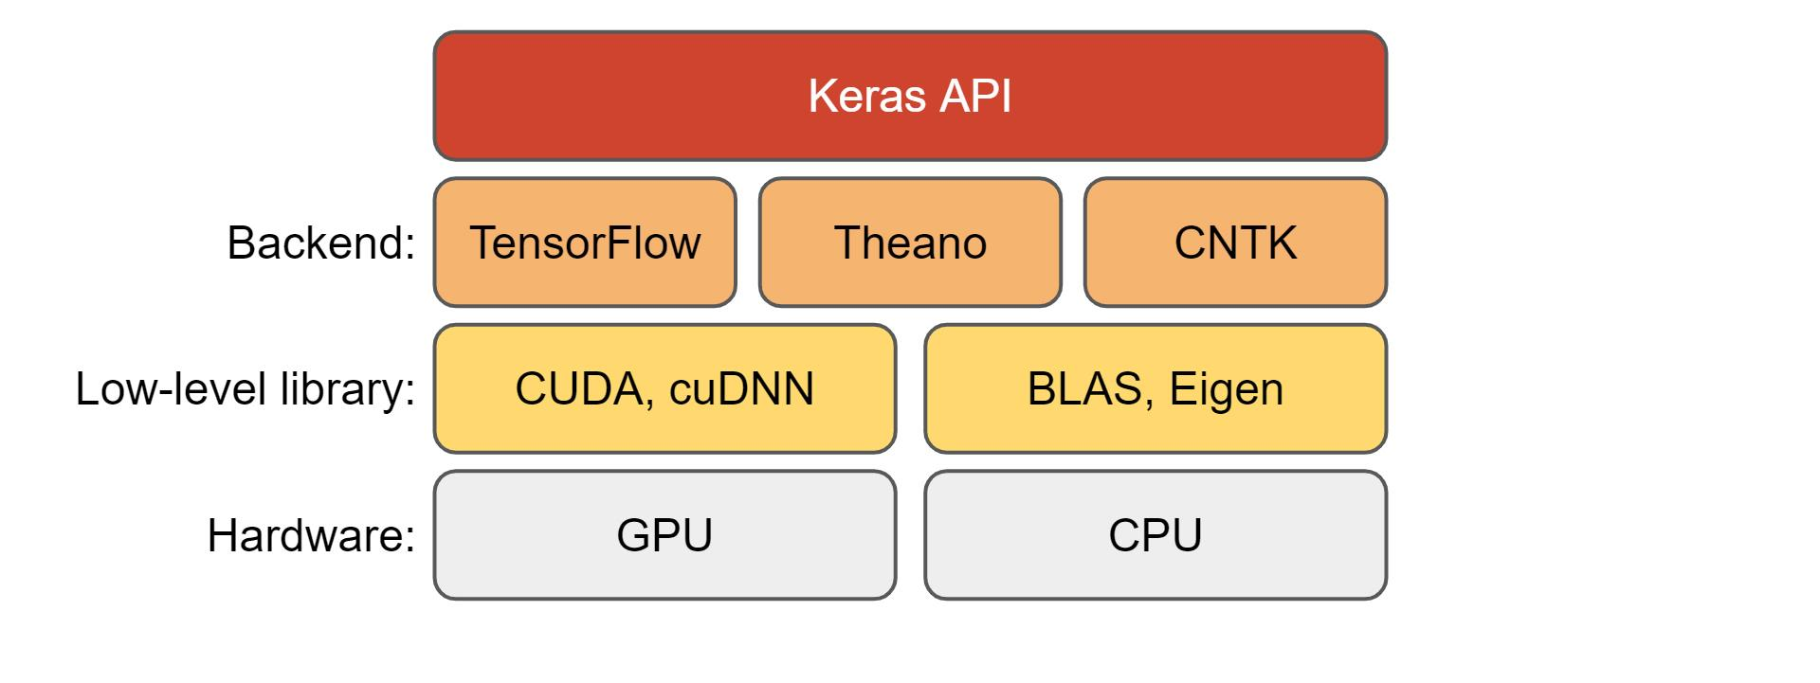
Keras

Slide 9
Neural Fortran
Neural network library written in Fortran
Fully connected layers
Backpropagation with mean squared error
Activation functions
Data parallelism
Curcic 2018

Slide 10
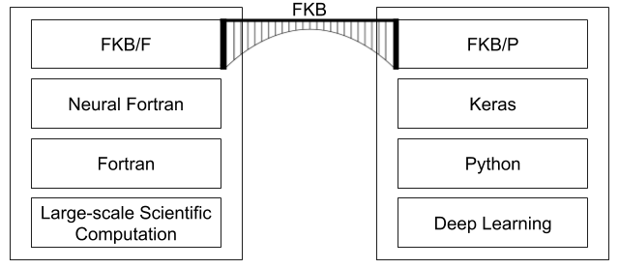
The Fortran-Keras Bridge (FKB)

Slide 11
Features of FKB/F
Custom layers
Fully connected
Batch normalization
Dropout
Training
Custom loss functions
Ensembles

Slide 12
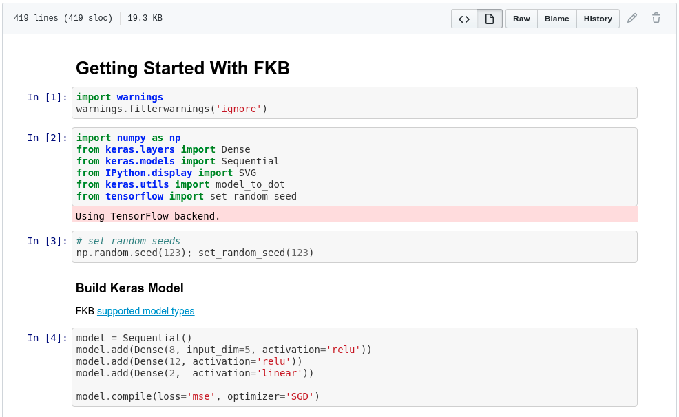

Slide 13
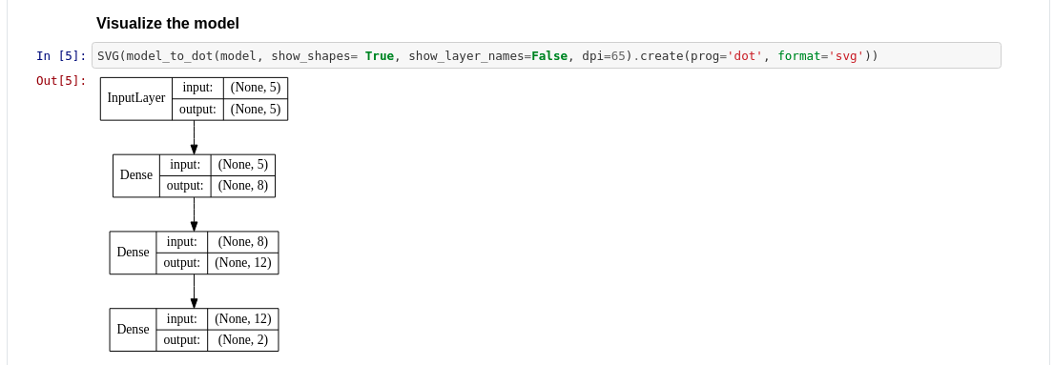

Slide 14
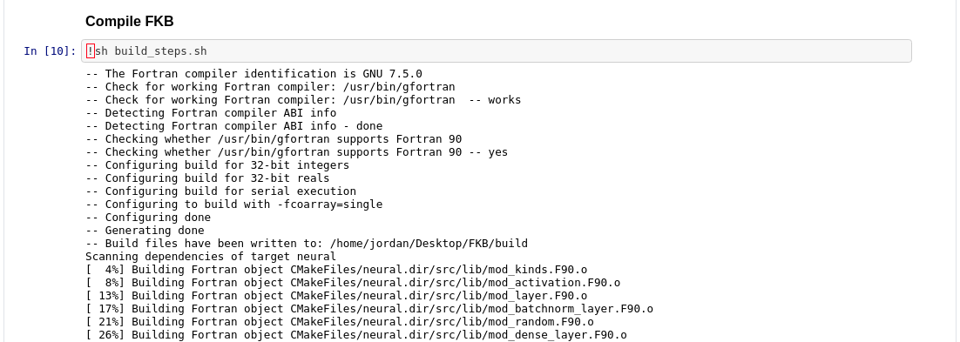

Slide 16
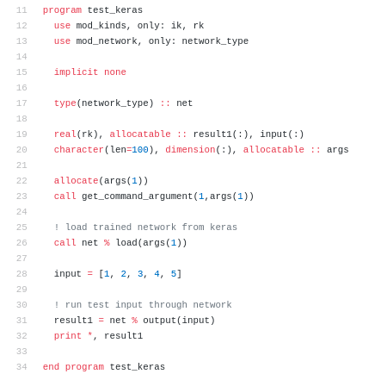

Slide 17
Climate Modeling
Build neural networks in Keras
100 networks with different hyperparameters
Train on historical data
Transfer them to Fortran via FKB
Run them coupled with SPCAM
Climate modeling simulator
Written in Fortran

Slide 18
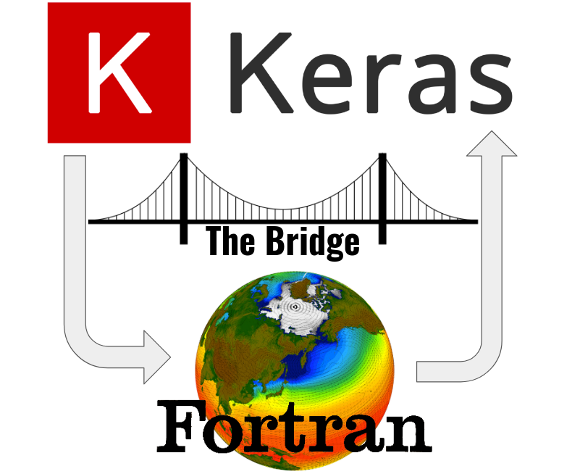

Slide 19
Without FKB
Extract parameters manually from Keras model
Hard code each layer interaction in Fortran
Any change to the model required:
Rewriting
Compiling

Slide 20
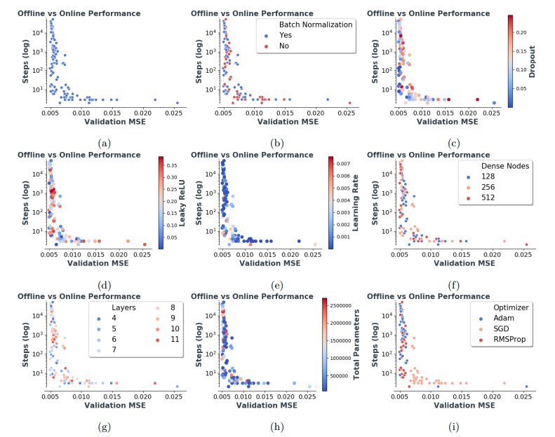

Slide 21
