Slide 1
Why you should use test automation on a Fortran Legacy Software: the AnaTest framework
Nicolas Abreu R L Netto, M.Sc Tiago Santana do Amaral, D.Sc Research Engineer
Electrical Network Department

Slide 2
Why test automation?
The main problem
How to continuously develop a software with small teams and frequent releases planned, minimizing bug creation and avoiding unwanted result changes?

Slide 3
Why test automation?
Machines work for humans; not otherwise
Testing is a necessary step to launch new or reviewed software
The development team must be sure that the software will perform as intended
New functions must yield proper results
New functions cannot break previous functions
Bug fixes cannot create new bugs
Although sometimes bug fixes can reveal old hidden bugs
Testing is usually a repetitive task
That can be given to a computer to execute and evaluate the results
If that step is performed automatically at some time interval, it can be called automated testing
Send code
Receive test results

Slide 4
Why test automation?
Tests types (for Fortran applications)
There are several techniques in software engineering that can be used to test programs:
Smoke testing, unit testing, integration testing, functional testing, keyword testing, regression testing, data driven testing, black box testing…
https://microsoft.github.io/code-with-engineering-playbook/automated-testing/
For Fortran applications, let’s consider just unit testing and black box testing
In general, every test will compare the observed output of the system with the expected (previously saved) output

Slide 5
Why test automation?
Unit testing
Evaluates individual components of a software
Outputs of functions and subroutines
It’s a good practice to implement new code with unit testing in mind
PURE and ELEMENTAL functions and subroutines are good candidates for unit testing
It’s not a formal (or even informal) requirement !!!
A function that converts data is a strong candidate to unit testing, like the following:
module function String2Epoch(str)
character(len=*), intent(in) :: str
real(8) :: String2Epoch
! Converts a human-readable timestamp to real EPOCH format
end function

Slide 6
Why test automation?
Black box testing
Examines the functionality of an application without peering into its internal structures or workings
In our experience, this is the most common technique used for testing Fortran programs
The user gives an input to the binary and analyses the output files of the program
It’s necessary to have a file parser (differ) for most evaluations
Ideally, the output file will have no difference from the reference file
In practice, some information is unique to each run, like timestamps, computational times…
It´s necessary to ignore some differences in the comparison process
Some calculations may float a little bit when performed in different processors, OS, arch…

Slide 7
Why test automation?
Automated tests as a Continous Integration step
Automated tests play an important role in Continuous Integration systems
TeamCity, Jenkins…
In short, for each commit:
Compile (build) the project
Test the compiled binary
Produce (pack) the installer
This process allows the development team to:
Fast detect errors
Build and test steps
Easily have installers ready for distribution

Slide 8
Why test automation?
Real-life example

Slide 9
Why test automation?
What was wrong? Let’s analyze the commit
It was suposed to be IT==47!!!

Slide 10
Why automation tests?
Alternatives
Fortran code + C++ “bridge Project” + C# Framework

Slide 11
Why automation tests?
Why did we create our own framework
Fortran Testing Framework
No black box testing (no file deployment)
No Visual Studio/TeamCity integration
It was hard (in 2015) to find help online
It’s specific for Fortran (some of our projects were in C# and C++)
Fortran code // C++ “bridge Project” // C# framework
Our choice in 2015
The same framework (Visual Studio Unit Testing) could be applied to every Project
It was easy to implement a file differ to black box testing
Eventually our projects were crashing when the test number was high

Slide 12
The AnaTest Framework
General Features
Deployment
The framework sets up (and tears down) an optional temporary deploy directory where the tests run
The framework automatically cleans up this deploy directory
API for C, C++ and Fortran
The tests are written and configured inside a normal program written in a language where the developer is comfortable
This program can be linked to the code under test, if this code is in a static library
Or it may be a standalone program that calls the program under test (via system calls)

Slide 13
The AnaTest Framework
General Features
Test selection
The test program accepts as arguments a filter specifying which tests should run (if no arguments are given, all tests run)
GoogleTest output file
When the tests run, the farmework generates an XML result file with the same contents as GoogleTest: this eases the integration with both Visual Studio and TeamCity

Slide 14
The AnaTest Framework
Features
Basic support functions
Compatibility functions across different platforms/compilers
File system: CREATE_DIR, REMOVE_DIR, COPY_DIR, REMOVE_FILE, COPY_FILE
Programming environment: GET_ENV, SET_ENV
Measure the time that specific tasks took: PARTIAL
Functions to configure tests (from inside the program):
DEPLOY, DEPLOY_COPY: either create a hard link or actually copy the given file/directory from to a temporary deploy directory created by the framework when the test is run
GET_WORKDIR: return the path to the temporary deploy directory
NODEPLOY: disable the creation of the temporary deploy directory
SET_MAX_OLD_DIRECTORIES: sets the maximum number of old temporary directories that are kept after the test runs (Default: 10). Every deploy directory that is older than this number is automatically removed by the framework after the test runs.

Slide 15
The AnaTest Framework
Features
Functions to configure tests (cont.):
IGNORE_STR, IGNORE_STR_EXACT, REMOVE_IGNORE_STR, REMOVE_IGNORE_STR_EXACT: sets/removes a regex or an exact string to be ignored when comparing text files (more on that later).
SET_MAX_LINES_TO_PRINT: sets the maximum number of lines that should be printed when a file comparison fails (default: 10).
SET_TIMEOUT: sets the maximum number of seconds a test is expected to take. If any test take more than this value to run, it is automatically killed by the framework.
Macros to start/end testing code:
TEST, ENDTEST: groups code with a given name

Slide 16
The AnaTest Framework
Features
Functions to compare values (unit testing):
FAIL(MSG): forces a fail message
CHECK(EXP): emits a fail message if the expression evaluates to false
CHECK_I4_EQ(A, B): compare two integer*4 values and prints a fail message if they differ
CHECK_I4_NE, CHECK_I4_GT, CHECK_I4_GE, CHECK_I4_LT, CHECK_I4_LE: similar functions for other types of comparison
CHECK_I4_CLOSE, CHECK_I4_NOT_CLOSE: compare with a tolerance
CHECK_R8_EQ(A, B): compare two real*8 values and prints a fail message if they differ
CHECK_R8_NE, CHECK_R8_GT, CHECK_R8_GE, CHECK_R8_LT, CHECK_R8_LE: similar functions for other types of comparison
CHECK_R8_CLOSE, CHECK_R8_NOT_CLOSE: compare with a tolerance
CHECK_STR_EQ(A, B): compare two character(*) values and prints a fail message if any of their ASCII characters differ
CHECK_STR_NE, CHECK_STR_GT, CHECK_STR_GE, CHECK_STR_LT, CHECK_STR_LE: similar functions for other types of comparison
CHECK_STR_CLOSE, CHECK_STR_NOT_CLOSE: use a “glob” wildcard to compare string

Slide 17
The AnaTest Framework
Features
Functions to execute programs and compare files (black box testing):
EXECUTACOMANDO: runs a system command with configurable output (legacy name)
CHECK_TXT_EQ(FILE1, FILE2): compare two text files contents and prints a “diff” if the files are not equal
IGNORE_STR(str): Specific strings inside these files are ignored, based on the test configuration
CHECK_BIN_EQ(FILE1, FILE2): compare the bytes of two binary files and emits a fail message it They are not an exact match
CHECK_PLT_EQ(FILE1, FILE2, TOLA, TOLR): compare the numeric contents of two files, with absolute and relative tolerances (specific for plot files generated by PlotCepel)
CHECK_DUMP_EQ(FILE1, FILE2, TOLA, TOLR): compare the numeric contents of two files, with absolute and relative tolerances (generic files)

Slide 18
The AnaTest Framework
Usage
To create a test, the user creates either a C, C++, Fortran 77 or Fortran 90 project (usually in Visual Studio).
There are declarations of all the functions/macros in both, .h, .fd and .f90 files.
Then write a subroutine with a fixed name: “ANATEST”
This function configures the tests
And calls other functions/subroutines where the tests are defined
In C++, the TEST macro works like a function and auto-registers the test without the need to call it
Then write the other functions using the macros/functions to group and run tests

Slide 19
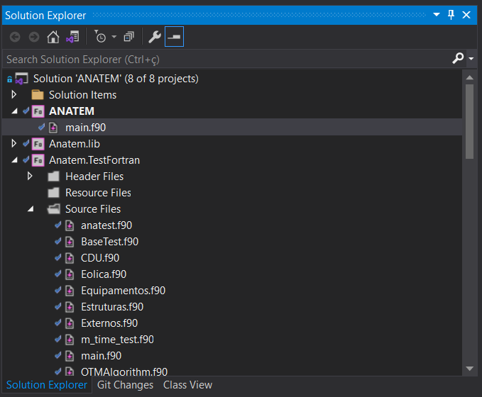
The AnaTest Framework
Usage
The project must have no “program” or “main” clauses. The entry point is within the AnaTest framework.
The new “program” is just a shell for calling the old “program anatem”, now “subroutine anatem”

Slide 20
The AnaTest Framework
Example (Fortran 77)
Configuration:
subroutine ANATEST
# include 'Anatest/anatest.blk'
implicit none
! Sets the timeout (in seconds)
call SET_TIMEOUT(2)
call SET_MAX_LINES_TO_PRINT(5)
call IGNORE_STR_EXACT('subroutine')
! Deploys the used files in black-box texting to the workdir
call DEPLOY('../../../../AnaTest/samples', '.’)
! Calls the test routines
call TesteEmOutraRotina
call TesteEmOutroArquivo
end

Slide 21
The AnaTest Framework
Example (Fortran 77)
subroutine TesteEmOutraRotina
# include 'Anatest/anatest.blk'
implicit none
character(len=3) str
str = 'abc'
call SET_ENV('SOME', '123’) !equivalent to, in shell: export SOME=123
TEST('PassTesteEmOutraRotina’)
!Black-box testing of file ‘anarede_input.for’ against ‘anarede_original.for’
call CHECK_TXT_EQ('anarede_input.for', 'anarede_original.for’)
!Unit testing of some trivial expressions
call CHECK_I4_EQ(1 + 1, 2)
call CHECK_R8_CLOSE(2 + 2, 4.1, 0.5)
call CHECK_STR_EQ(str, str)
call CHECK_STR_CLOSE(str, 'a*c')
call GET_ENV('SOME', str)
call CHECK_STR_EQ(str, '123')
ENDTEST
end

Slide 22
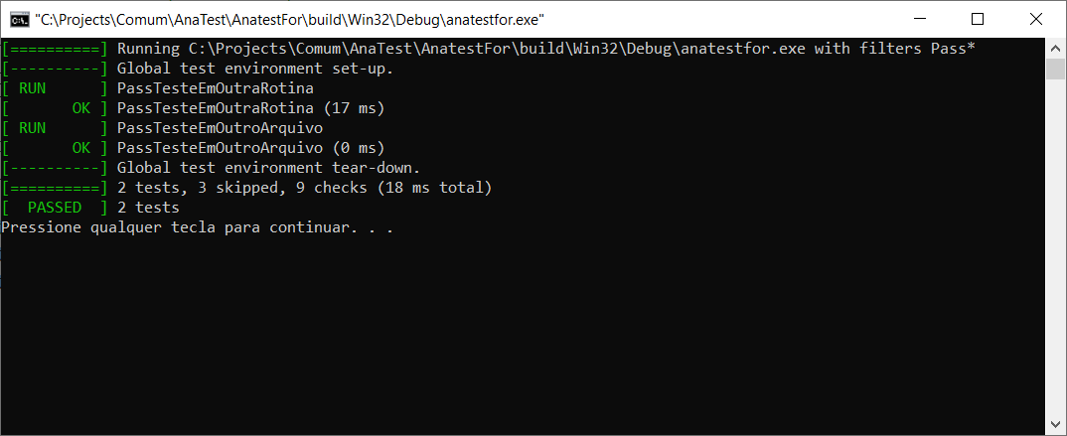
The AnaTest Framework
Results
When all tests pass:

Slide 23
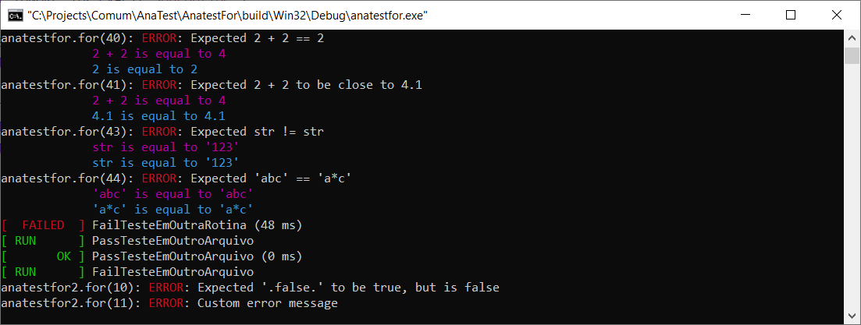
The AnaTest Framework
Results
When two values differ (unit testing):

Slide 24
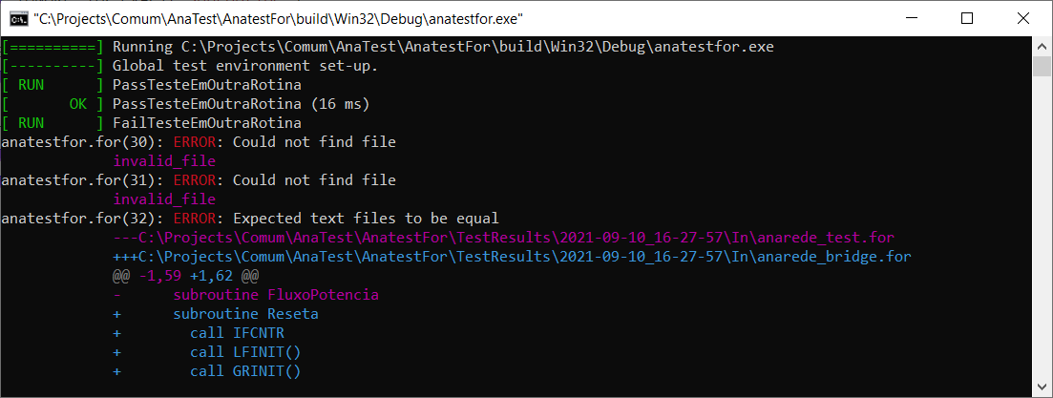
The AnaTest Framework
Results
When two text files differ (black box testing):

Slide 25
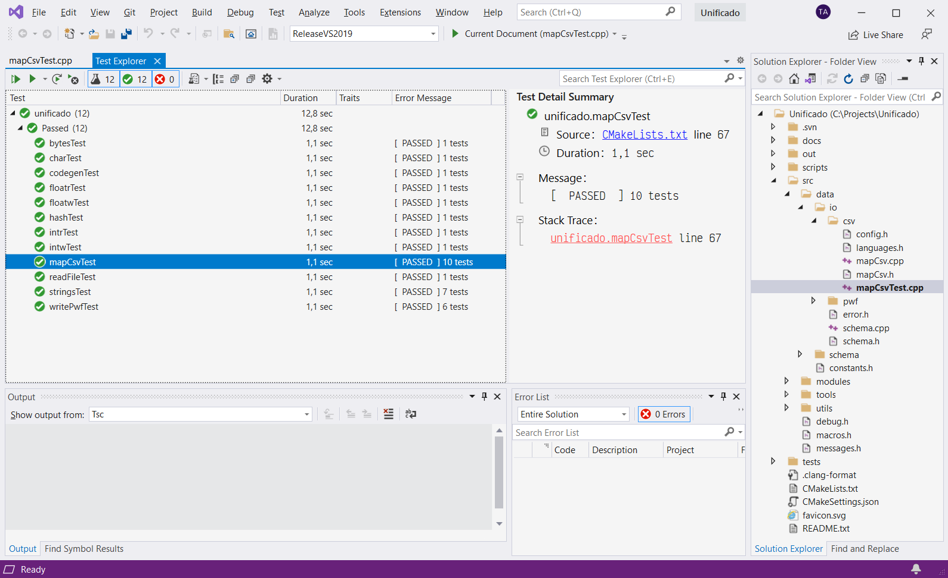
The AnaTest Framework
Integration with Visual Studio via Cmake/CTest

Slide 26
The AnaTest Framework
Integration with TeamCity (GoogleTest xml parser)

Slide 27
Final thoughts
Test implementation: an ongoing task
Anatem test count
VisualStudio Test (mostly black-box testing)
AnaTest
(unit and black-box testing)
First test implementation 25 May 17
AnaTest framework migration 05 Feb 20

Slide 28
Final thoughts
Test implementation: Where to begin
Start converting the manual black-box tests into an automatic testing framework
New features should have tests associated with it
It will decrease future maintenance cost
Tests should be created when bugs are discovered and fixed
It will prevent this bug from happening again

Slide 29
nicolasrln@cepel.br
tiago@cepel.br

Slide 30
Why automation tests?
Context
The Electrical Network Department of Cepel has three main goals
To develop power system operation and expansion software for the Brazilian Interconnected System (BIPS) studies
To perform advanced studies of the BIPS
To promote research and development in the Power Systems field

Slide 31
Why automation tests?
Commercial software development
Anarede
Flupot
Anafas
Optimal power flow
Simultaneous fault
Power flow
SIGER
Electrical network data management
Anatem
Eletromechanical stability
PacDyn
Small-signal stabilty
HarmZs
Harmonics
AnaHVDC
Multiple DC links stability
MODPOL
Auxiliary software

Slide 32
Why automation tests?
Two major examples
Frequent releases
(8 versions in 2019; 8 in 2020; 5 in 2021)
Active development
(150 major functionalities in the past 5 Years)
New software developed from the ground up
Code reliability is low, since it is very new
The methodology is in active development
How to avoid bugs when the requirements can change so often?

